Slide 1
Bazele inteligenței artificiale
Laborator – Grigore Ionuț

Slide 2

today’s lab

Slide 3
Content
k-Nearest neighbors
SVM:
  Linear SVM classification
  Nonlinear SVM classification
  SVM regression

Slide 4
Big picture first, details last

Slide 5
1) k-Nearest neighbors

Slide 6
Classification

Slide 7
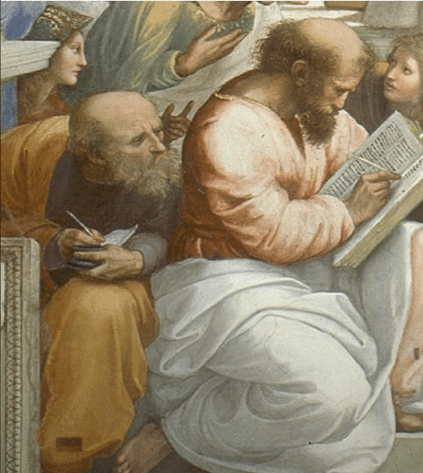
Life is better with an example…

Slide 8
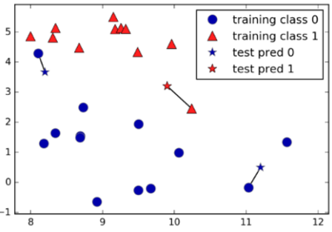
We have some points:

Slide 9
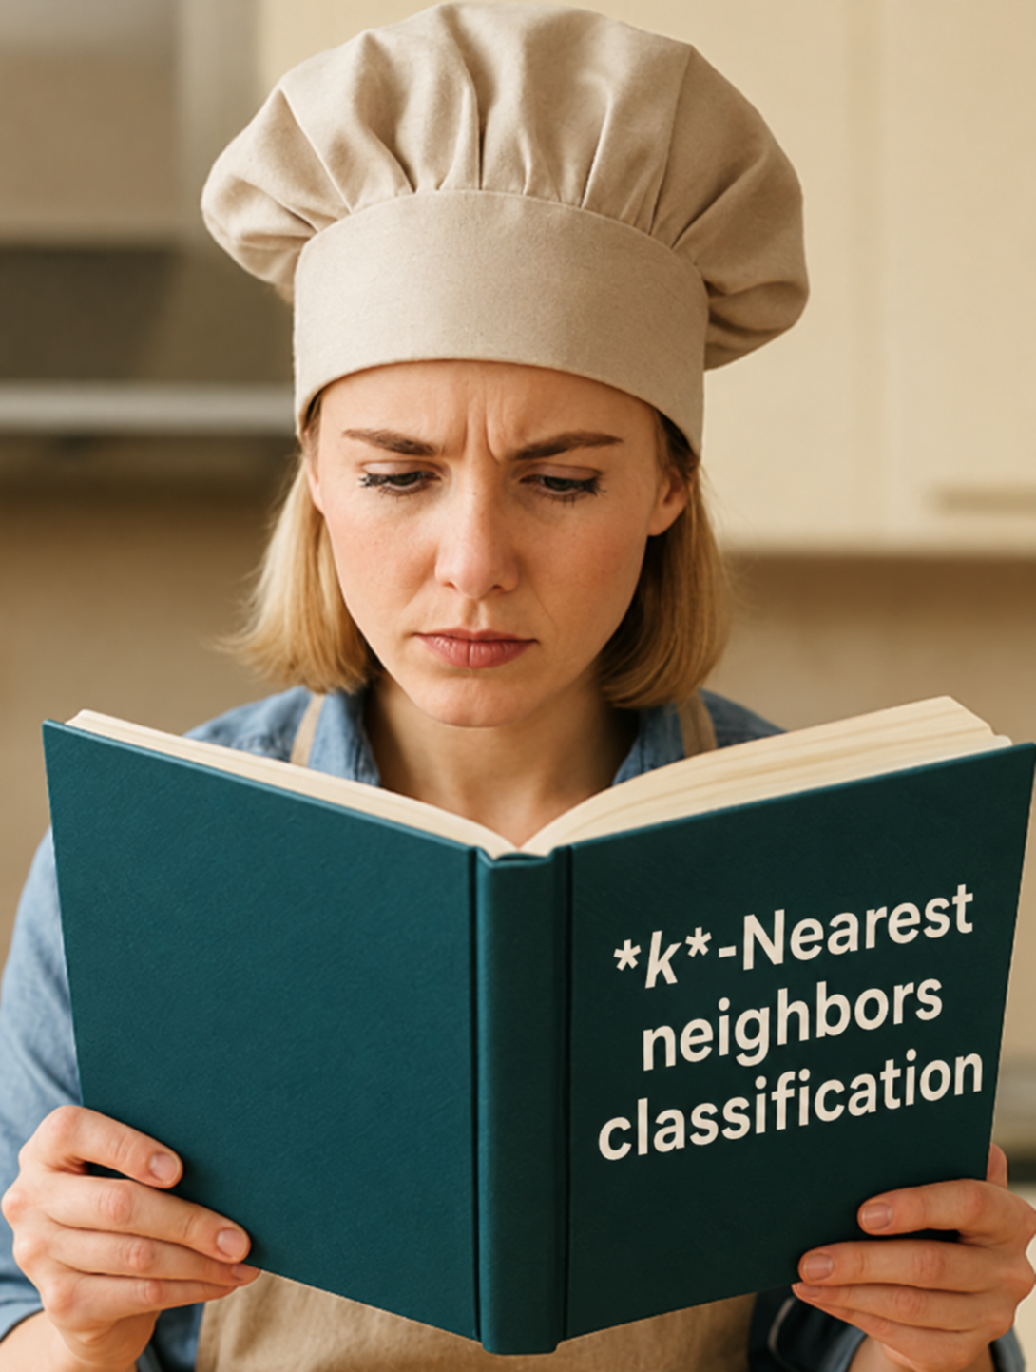
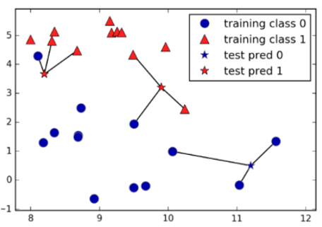
Training: store the training data.
Prediction for a new point:
  find the k nearest training points.
  assign the most common class among them.
1-nearest neighbor classification
3-nearest neighbor classification

Slide 10
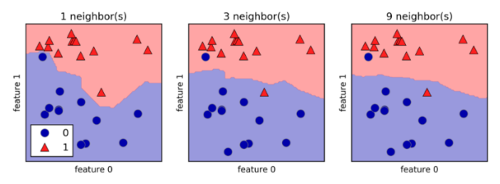
Applying this rule to every point in the plane colors the entire space:

Slide 11
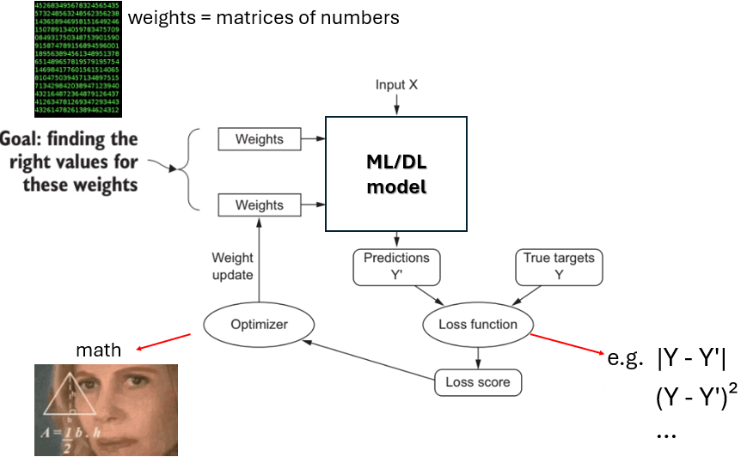
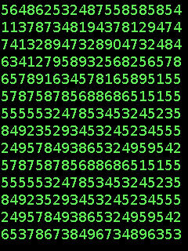
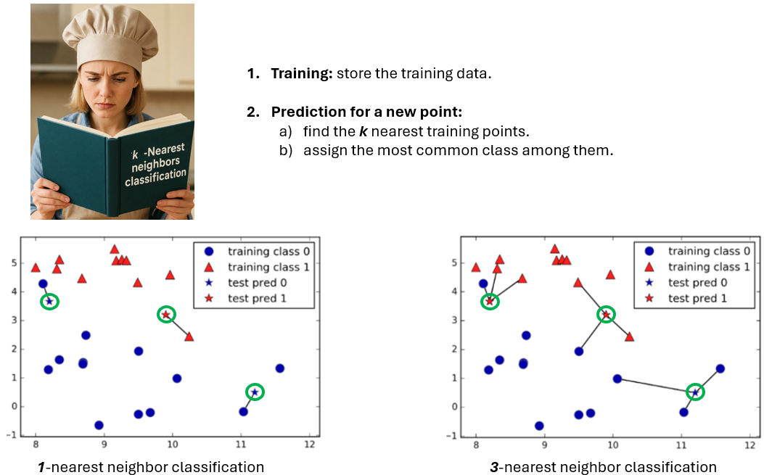

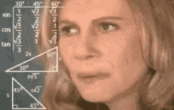
⚠️ NOTE

Slide 12

k-Nearest neighbors
nonparametric model
we don’t have parameters w
we don’t have loss function
we don’t have gradient descent
TL;DR: k-Nearest neighbors = an exception

Slide 13
Regression

Slide 14
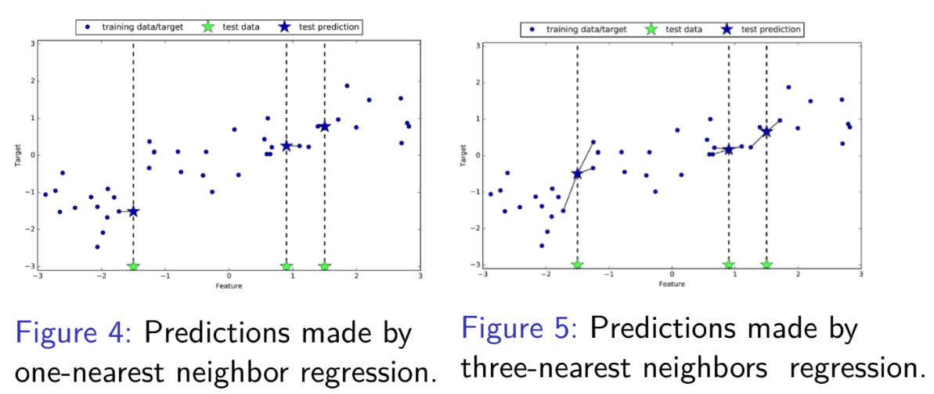
1-nearest neighbor regression
3-nearest neighbor regression
For each green star:
Look along the X-axis for the single closest blue dot.
Take that blue dot's Y-axis value.
Use that exact value as the prediction (dark blue star).
For each green star:
Look along the X-axis for the 3 closest blue dots.
Take the Y-axis values of all 3 blue dots.
Average those 3 values to get the prediction (dark blue star).

Slide 15
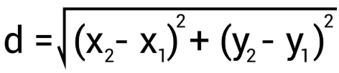
2 important things are essential for k-Nearest neighbors:
  the number of neighbors (1, 2, 3…)
  how we measure the distance between data points
  (Euclidean distance is commonly used)

Slide 16


Slide 17


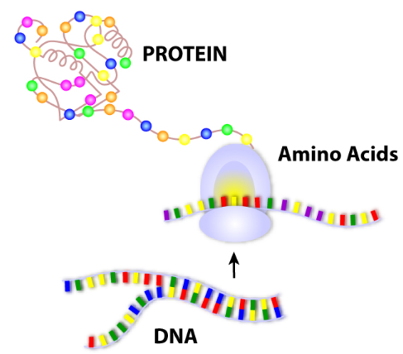
Real-World Uses of k-Nearest Neighbors (k-NN)
Where k-NN is used (some examples):
Healthcare: Predicting disease based on patient similarity (e.g., diabetes, heart disease).
Recommendation systems: “Users who liked this also liked…” (product or movie similarity).
Bioinformatics: Classifying genes or protein sequences by similarity.

Slide 18
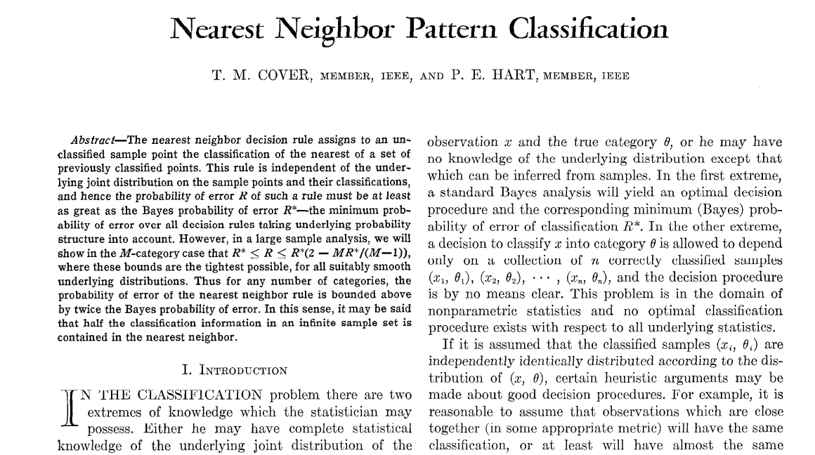
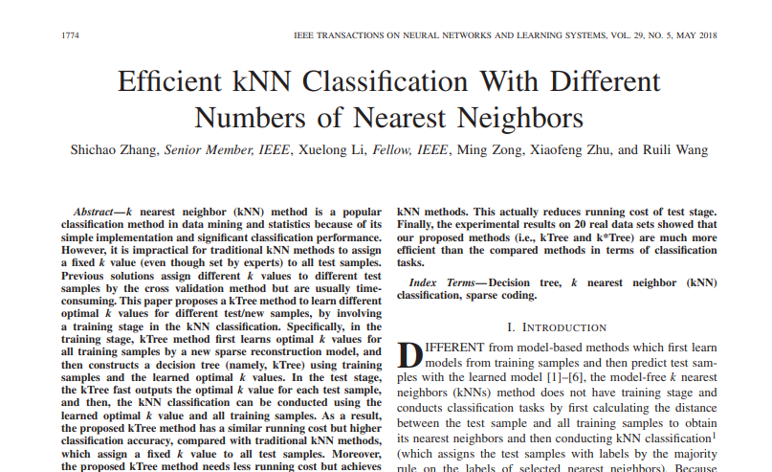
Notable papers
Cover & Hart (1967) — Nearest neighbor pattern classification → foundational work.
Zhang et al. (2017) — Efficient kNN classification with different numbers of nearest neighbors

Slide 19
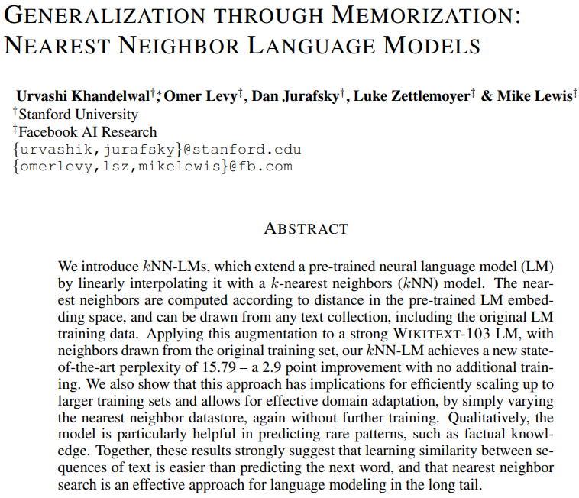
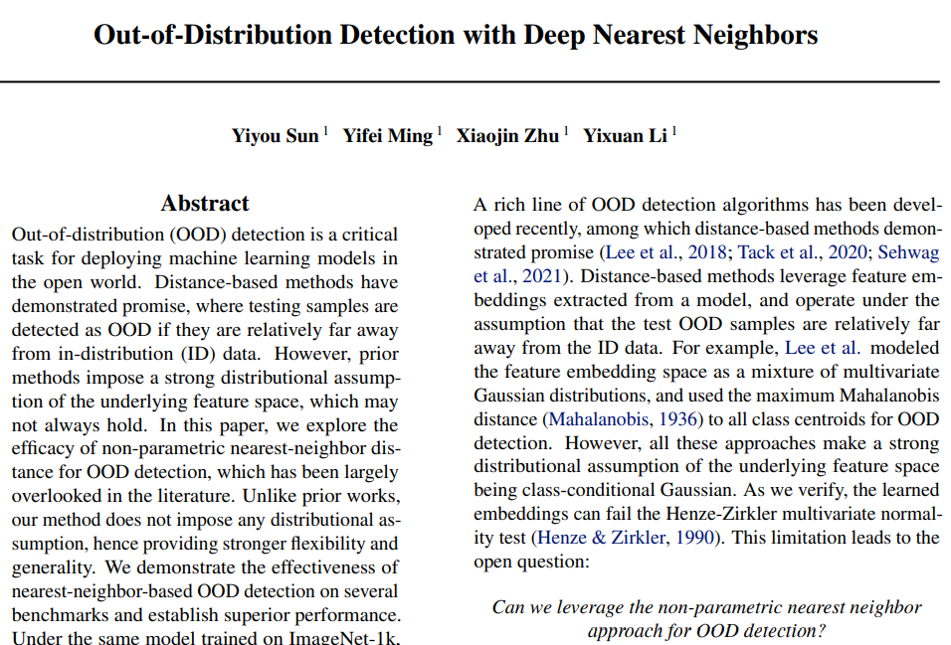
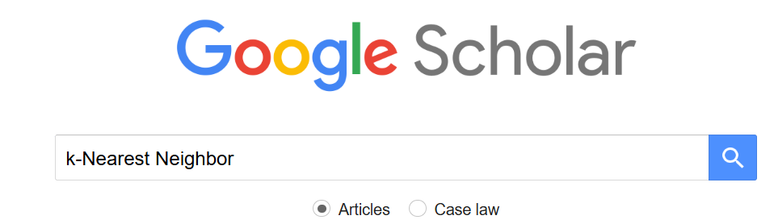
Notable papers
Khandelwal et al. (2020) — Generalization through Memorization: Nearest Neighbor Language Models
Sun et al. (2022) — Out-of-Distribution Detection with Deep Nearest Neighbors
and many other examples…find more here on Google Scholar:

Slide 20
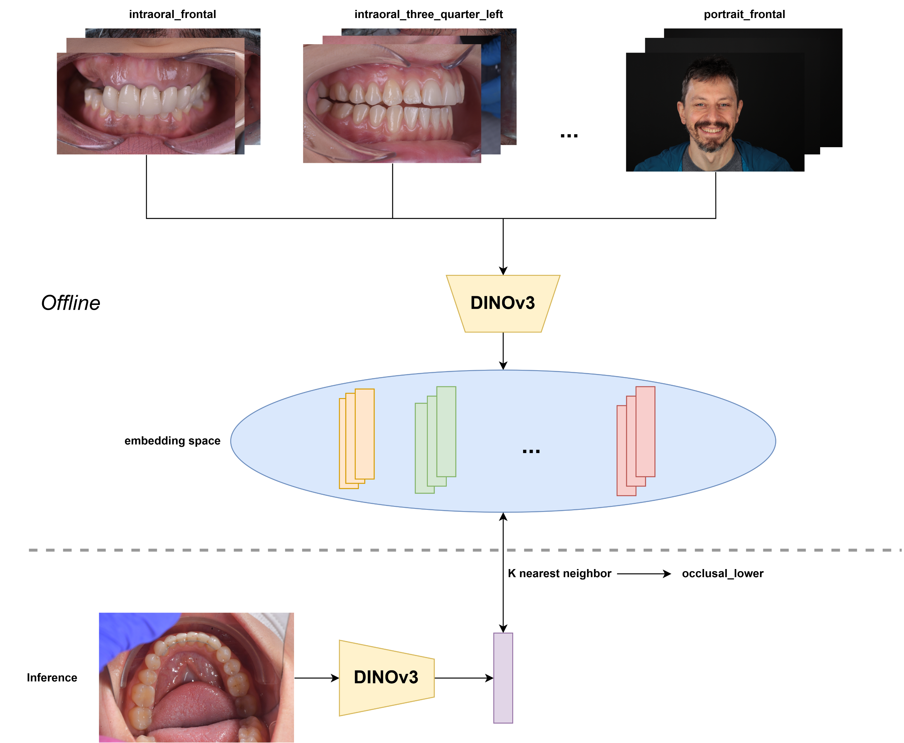
vectors of numbers
vector of numbers

Slide 21
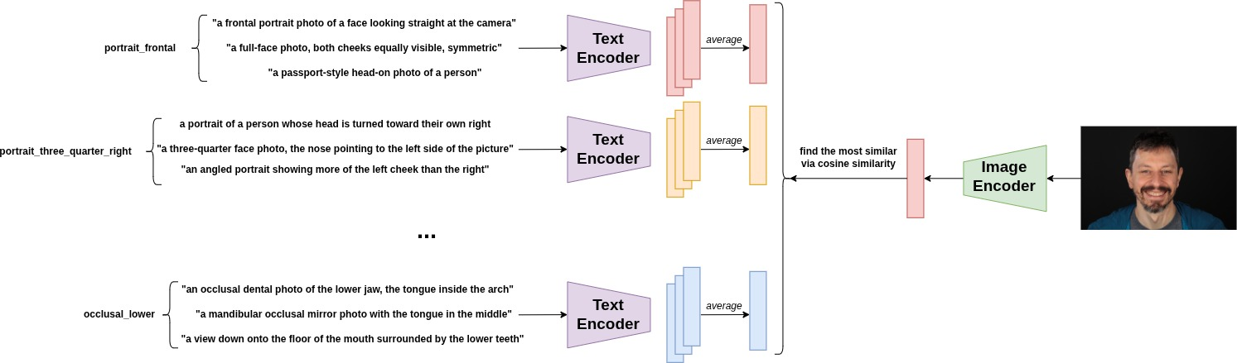
vectors of numbers
1 nearest neighbor
vector of numbers

Slide 22
Code part

Slide 23

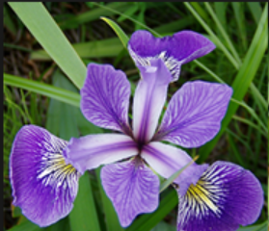
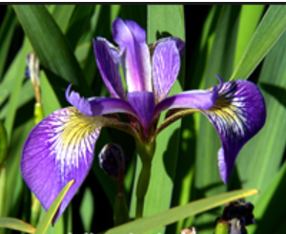
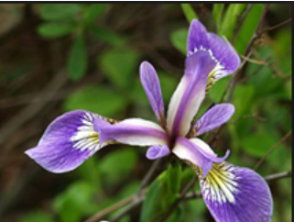
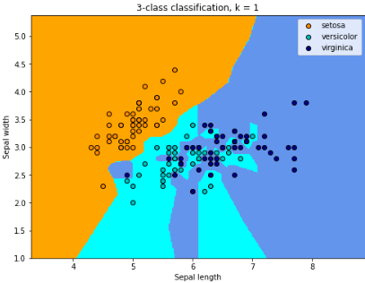
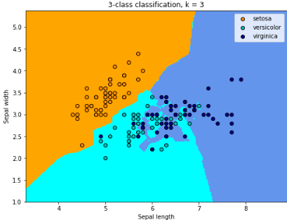
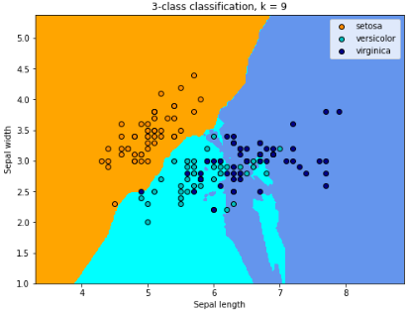
versicolor
setosa
virginica
k-Nearest neighbors
based on:
sepal width
sepal length
ML/DL
model

Slide 24
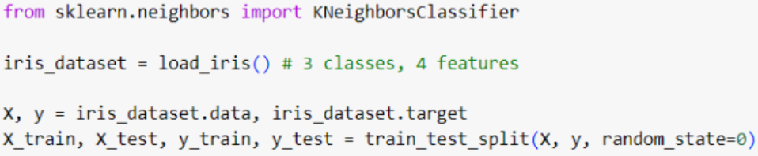
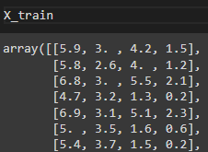
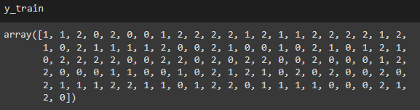
3 classes of flowers:
setosa (0)
versicolor (1)
virginica (2)
sepal length
sepal width
petal length
petal width

Slide 25
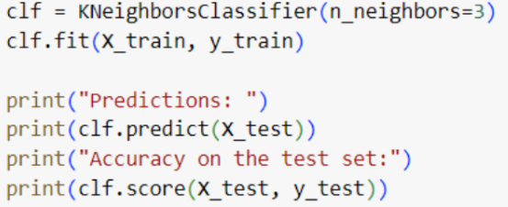
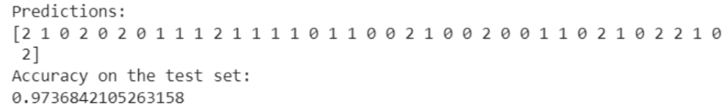
⚠️ NOTE
here we applied KNeighborsClassifier only for the first 2 features (sepal width and sepal length) because we cannot plot 4D figures ! ☺

Slide 26
2) Linear SVM classification

Slide 27
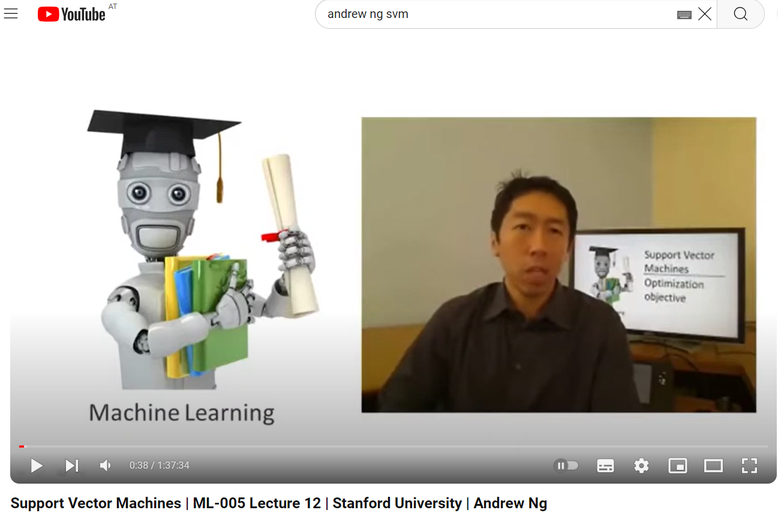
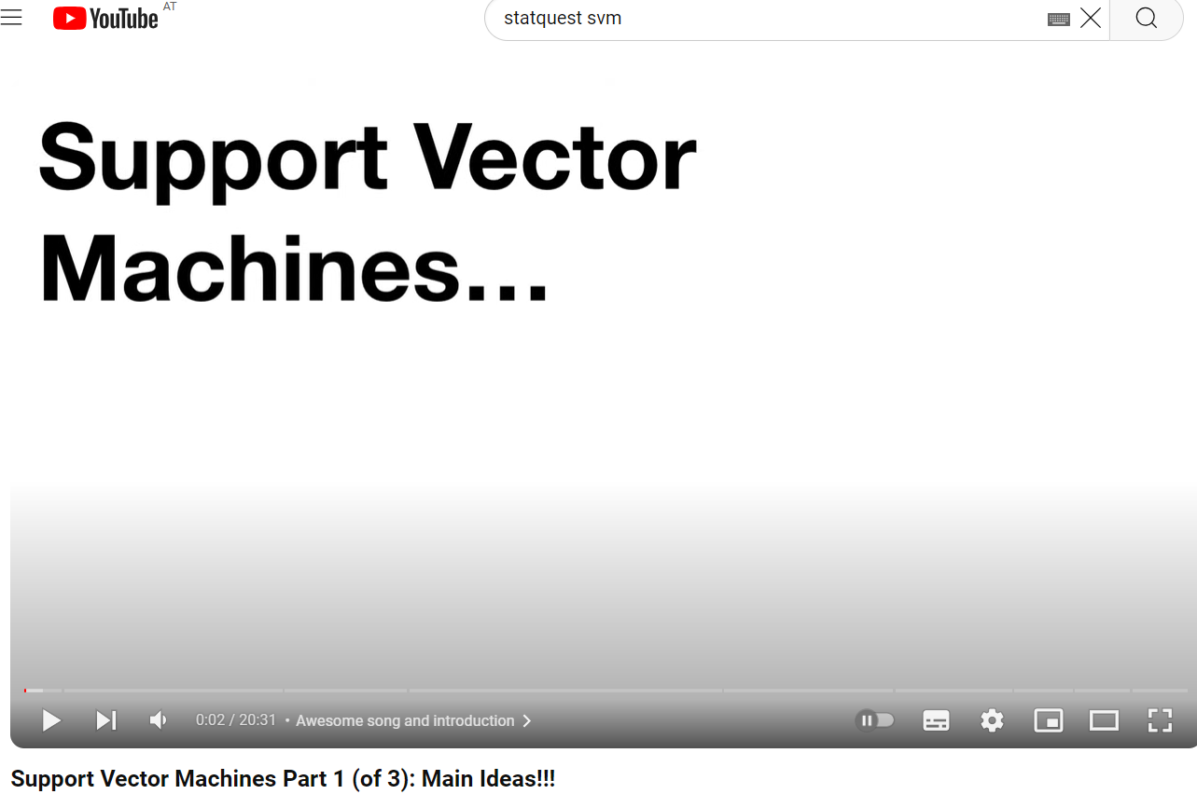

Slide 28
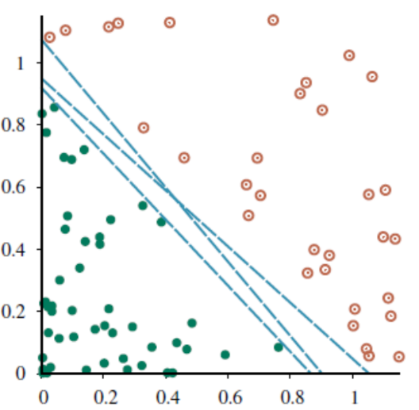
We have this dataset:
GOAL: Separate the green points from the red points by a line.

Slide 32
Infinitely many solutions !

Slide 33
Solution ?

Slide 34
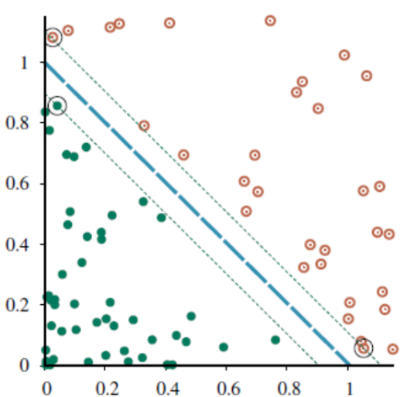
margin
support vectors
maximum margin separator
TL;DR: Pick the line with the widest possible gap (margin) to the nearest points.

Slide 35
Now what if …

Slide 36
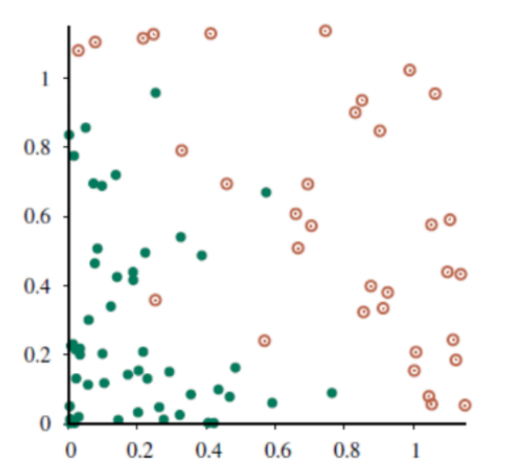


Slide 37
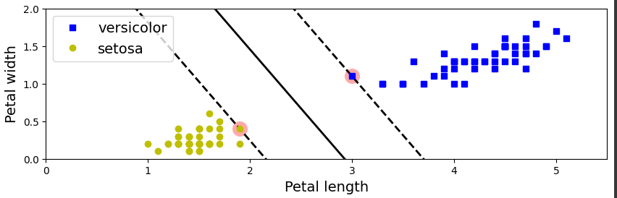
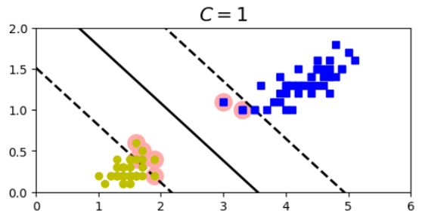
TL;DR:
Hard Margin SVM: Forces a strict boundary with no misclassified points (only works when data is perfectly separable).
Soft Margin SVM: Allows a few misclassified points to achieve a better overall boundary for noisy data.

Slide 38

The math behind

Slide 39
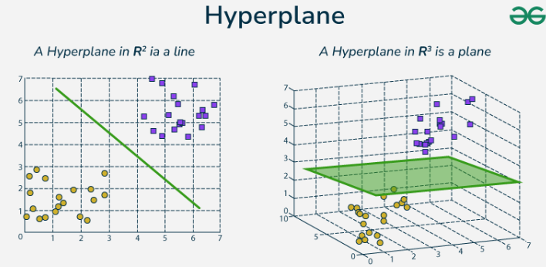

In general, a hyperplane is defined by the following equation:

Slide 40

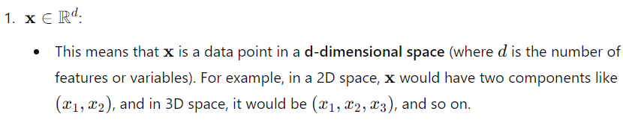
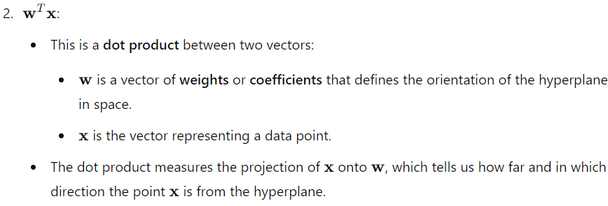
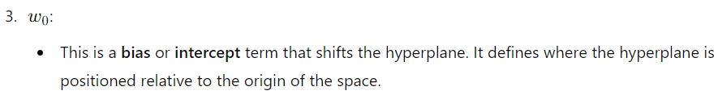
NOTE 1
NOTE 2

Slide 41
NOTE 1
Direction: The sign of the dot product tells us which side of the hyperplane the point is on:
  If , then lies on the side of the hyperplane that corresponds to one class (say, class +1).
  If , then lies on the other side of the hyperplane (say, class -1).
Distance from the hyperplane: The magnitude (absolute value) of the dot product tells us how far the point is from the hyperplane. If the dot product is large, the point is far from the hyperplane. If it's small, the point is close to the hyperplane.
In summary, the dot product helps the SVM decide both which side of the hyperplane a point is on (classification) and how far it is from that boundary (confidence in the classification).
NOTE 2
Positioning the hyperplane: The term shifts the hyperplane away from the origin. Without the hyperplane would always pass through the origin, which is not flexible enough for most classification problems.
  Positive shifts the hyperplane in one direction away from the origin.
  Negative shifts it in the opposite direction.
By adjusting the SVM can position the hyperplane at different places in the space, allowing for more flexibility in finding the optimal decision boundary that best separates the two classes.

Slide 42




when training the classifier, we want to ensure that the examples with positive labels are on the positive side of the hyperplane:
and the examples with negative labels are on the negative side:
these 2 conditions are often presented in a single equation:

Slide 43




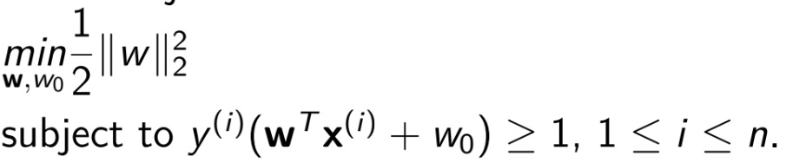
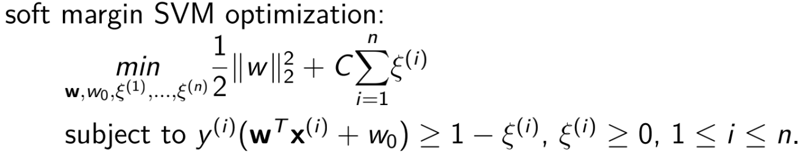
.
.

Slide 44
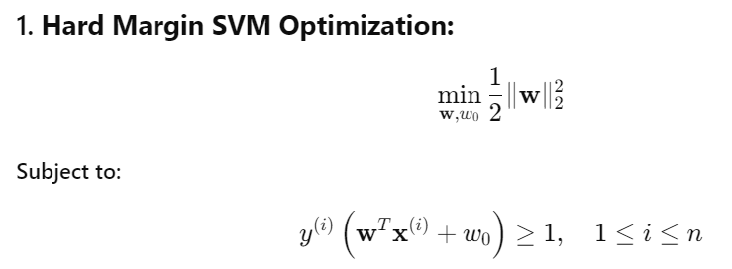
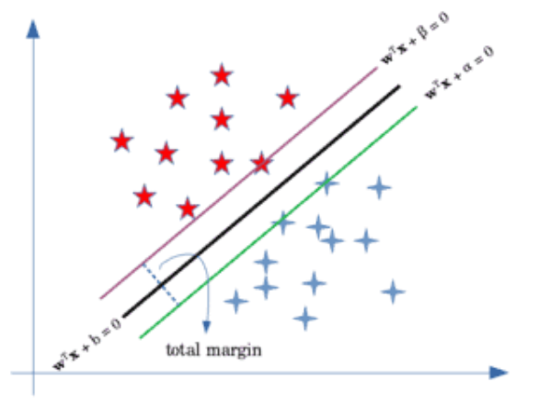
The hyperplane that separates the 2 classes is defined by:
w^{T}x+a = 0
w^{T}x+w₀ = 0
w^{T}x+b = 0
Then, the 2 parallel hyperplanes that define the margin (purple and green line) are:
Let’s assume we have the following dataset:
w^{T}x+a = 0
w^{T}x+b = 0
w^{T}x+w₀ = 0
margin

Slide 45
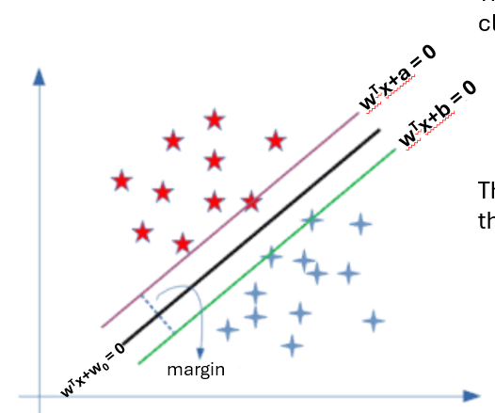

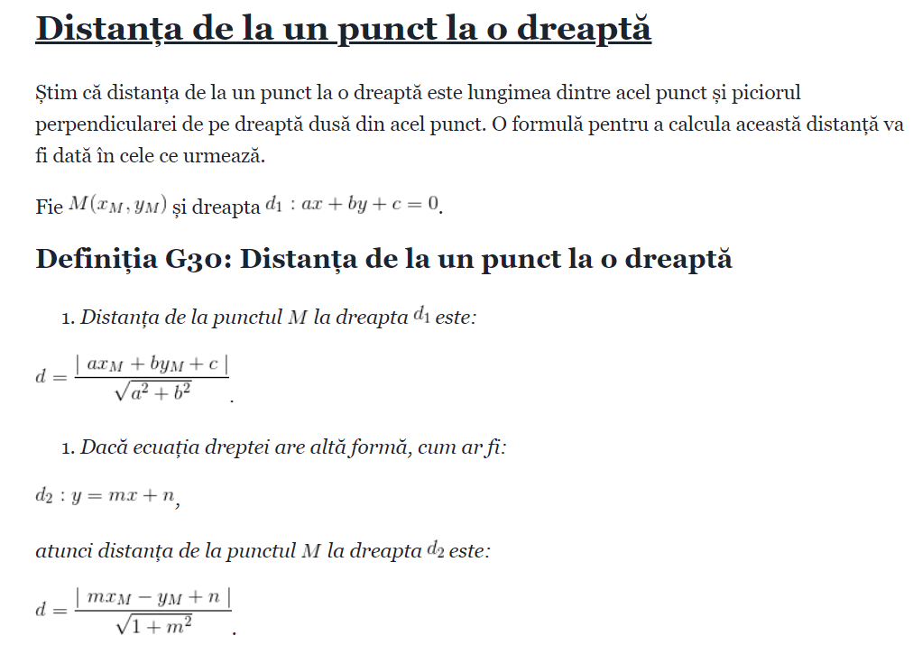



Without allowing any misclassifications in the hard margin SVM, we want to maximize the distance between the two hyperplanes.
To find this distance, we can use the formula for the distance of a point from a plane So the distance of the blue points and the red point from the black line would respectively be:
.
a
b
2
2
As a result, the total margin would become:
a
b
2
We want to maximize this margin. Without the loss of generality, we can consider a = w₀-1 and b = w₀+1. Subsequently, the problem would be to maximize or minimize
2.
2
2

Slide 46





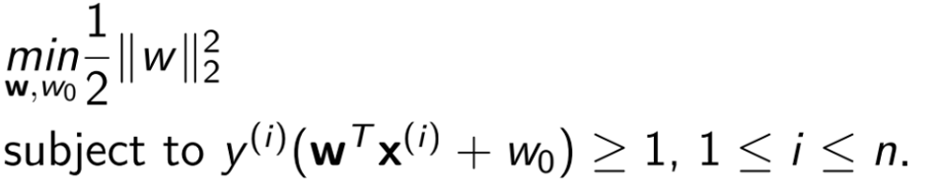
To make the problem easier when taking the gradients, we’ll instead work with its squared form:
(1)
w₀
2
This optimization comes with some constraints. Let’s assume that the labels for our classes are {-1, +1} (the red stars are +1 and blue stars are -1).
When classifying the data points, we want the points belonging to positives classes to be greater than +1 and the points belonging to the negative classes to be less than -1, meaning:
  w^{T}x+a 0 ⬄ w^{T}x+w₀-1 0 ⬄ w^{T}x+w₀ 1
  w^{T}x+b 0 ⬄ w^{T}x+w₀+1 0 ⬄ w^{T}x+w₀ -1
(2)
(1), (2)

Slide 47
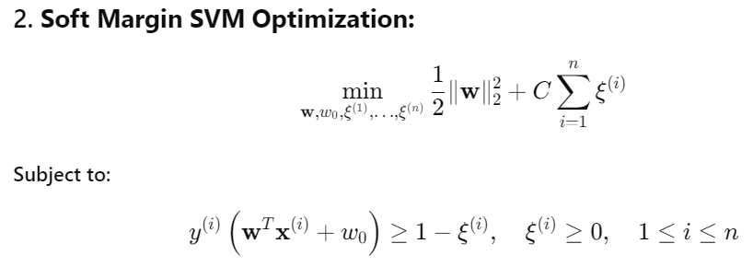
In a similar way as Hard Margin SVM Optimization but more numbers and Greek notations, for more info see the following link:
https://www.baeldung.com/cs/svm-hard-margin-vs-soft-margin

Slide 48
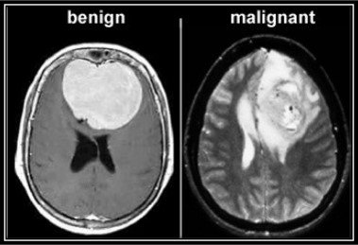



Real-World Uses of Support Vector Machines (SVM)
Where SVM is used (some examples):
Medical diagnosis: Classifying tumors (benign vs. malignant), disease detection from MRI or gene data.
Computer vision: Object / face recognition, handwriting classification (MNIST dataset).
Fraud detection: Detect unusual transaction patterns indicating fraud.

Slide 49


Notable papers
Cortes & Vapnik (1995) — Support-vector networks → the original SVM paper.
Guyon et al. (2002)— Gene selection for cancer classification using support vector machines

Slide 50



Notable papers
Sweilam et al. (2010) — Support vector machine for diagnosis cancer disease: A comparative study
Guide et al. (2024)— An Overview on the Advancements of Support Vector Machine Models in Healthcare Applications: A Review
and many other examples…find more here on Google Scholar:

Slide 51
Code part

Slide 52

versicolor
setosa
ML/DL
model
based on:
petal width
petal length
Linear SVM
hard margin
soft margin

Slide 53


Let’s build an SVM classifier to distinguish between the setosa and versicolor types in the iris dataset, based only on the petal length and petal width features:

Slide 54


1) Hard margin SVM
for hard margin C is set to +
it means that we want a perfect separation of the data without allowing any misclassifications
this means the decision boundary is a linear hyperplane
( a line, a plane, etc.) ☺
plot function from lab

Slide 55

1) Soft margin SVM
is used in SVM to calculate the error for misclassified points:
if the point is correctly classified, the loss is 0
if the point is misclassified, the loss is proportional to how far the point is from being correctly classified
a small value of C makes the SVM more tolerant of misclassifications and margin violations. The model will allow more points to be within the margin or even on the wrong side of the hyperplane
a larger C value forces the SVM to be stricter
plot function from lab

Slide 56
3) Nonlinear SVM classification

Slide 57


What happens if we have nonlinear datasets?

Slide 58



Slide 59
But …

Slide 60

This is a circle.
SVM works with:
lines
planes
etc.
C
l
P

Slide 61

SOLUTION:
add more features (e.g. polynomial features) such that to create a linearly separable dataset in higher dimensions

Slide 62






Nonlinearly separable
Linearly separable
Nonlinearly separable

Slide 63
Why ?

Slide 64


Slide 66


What is kernel trick?

Slide 67
Code part

Slide 68


our dataset

Slide 69



plot function from lab
You don’t need to worry about them.
You will have these parameters for test ☺

Slide 70




….or alternatively using the kernel trick…
plot function from lab
plot function from lab

Slide 71


…or using more sophisticated kernels…

Slide 72
What is kernel trick?

Slide 73
4) SVM regression

Slide 74




Slide 75


Slide 76


Slide 77
TL;DR — Intuiția din spatele SVM Regression (SVR)
În clasificare, SVM caută linia care separă cel mai bine două clase, lăsând un spațiu liber (margine) între ele.
În regresie, nu mai vrem să separăm clase, ci să desenăm o linie care urmează cât mai bine trendul datelor.
În jurul acestei linii, SVR creează o zonă-tub (ε):
→ punctele din interiorul tubului sunt considerate „predicții bune”,
→ iar cele din afară sunt erori (modelul nu le poate explica perfect).
Epsilon (ε) controlează cât de „larg” e acest tub:
  ε mare: modelul e mai tolerant, trece „printre” date fără să le urmeze prea exact.
  ε mic: modelul devine mai strict, încearcă să treacă aproape prin fiecare punct.

Slide 78
Code part

Slide 79




plot function from lab
You don’t need to worry about them.
You will have these parameters for test ☺

Slide 80




plot function from lab
You don’t need to worry about them.
You will have these parameters for test ☺

Slide 81



k-Nearest Neighbors (k-NN): Predicts using the closest data points.
  Classification: Chooses the most common label among neighbors.
  Regression: Averages their numeric values to make a prediction.
1-nearest neighbor
3-nearest neighbor
1-nearest neighbor
3-nearest neighbor

Slide 82
Linear SVM (Classification): Finds the best straight line (or plane) that separates classes with the largest margin between them.
hard margin
soft margin

Slide 83

Nonlinear SVM (Classification): Uses the kernel trick to bend the space, allowing separation when data isn’t linearly separable.

Slide 84

SVM Regression (Linear & Nonlinear): Tries to fit a line or curve that stays as close as possible to all points, but ignores small errors within a tolerance range (the “ε-tube”).
linear
nonlinear

Slide 85


Slide 86
Exercises

Slide 87


Slide 88
Big picture first, details last

Slide 89




Solutions

Slide 90




k=1
k=5
k=9

Slide 91
…or if we introduce a bit noise in data….

Slide 92



Slide 93



k=1
k=5
k=9

Slide 94



Slide 95



Slide 96



Slide 97



Slide 98


Slide 99


Slide 100
Thank you !

